Slide 1
Squash Project
Bellaterra, May 2018
Naci Kurdoglu, Nina Simakova, Vitalii Kudinov, Daniel Valerdi, Raffaele Bongo, Severino Mateus

Slide 2
Contents
Project proposal
Objectives of the project
Development
Results
Conclusions and improvements

Slide 3
Contents
Project proposal
Objectives of the project
Development
Results
Conclusions and improvements

Slide 4
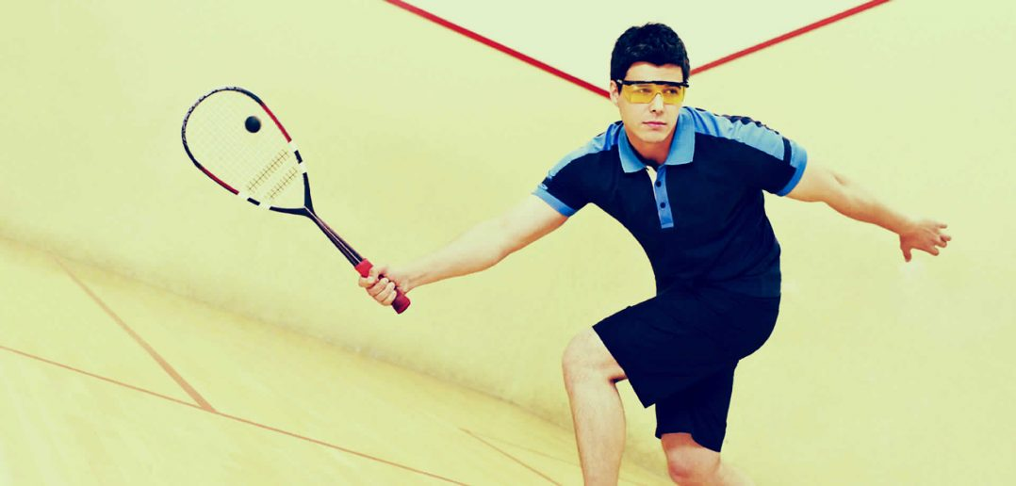
Project proposal
Our idea is to create a “Squash” game mechanic inside OpenGL environment.

Slide 5
Contents
Project proposal
Objectives of the project
Development
Results
Conclusions and improvements

Slide 6
Objectives of the project
The main objective of this project is the implementation of a graphical application in Visual C ++ and OpenGL with the following features:
Ability to influence motion control with Kinect
Realistic physics
Introducing a gameplay mechanic

Slide 7
Contents
Project proposal
Objectives of the project
Development
Results
Conclusions and improvements

Slide 8
Development diagram
Input: Kinect
Squash Project
Physics: Gravity + Collision
Window: Visualization

Slide 9
Development. Main tasks
Visualization
Lighting
Perspective and Orthogonal views
Physics
Kinect

Slide 10
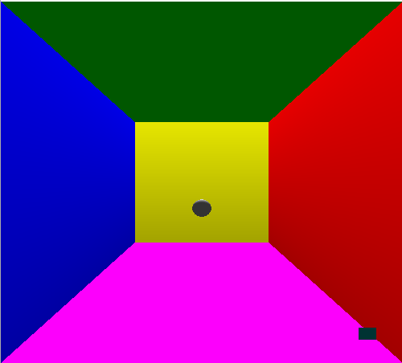
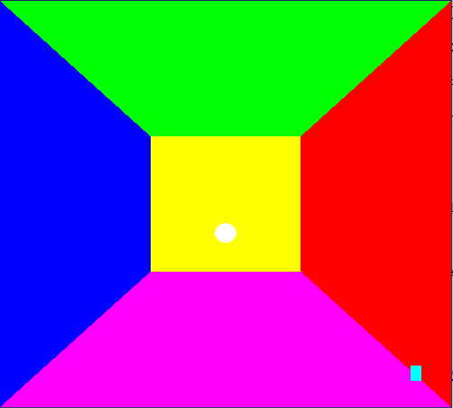
With lighting
W/o lighting

Slide 11
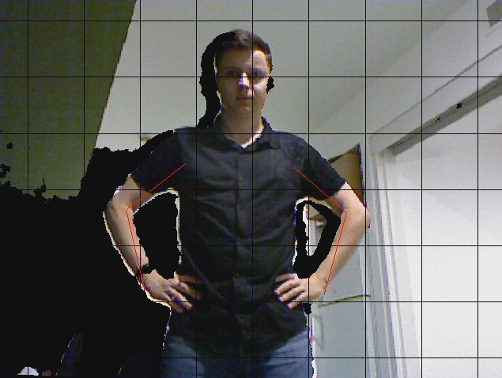
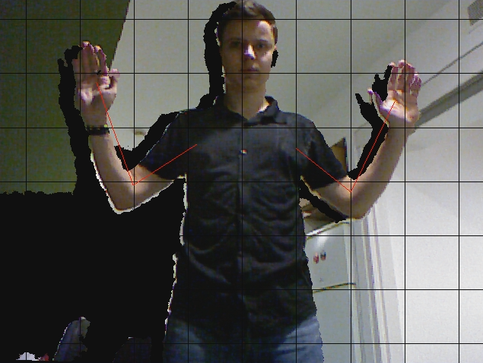
Kinect MOCAP

Slide 12
Contents
Project proposal
Objectives of the project
Development
Results
Conclusions and improvements

Slide 13
Launching Demo...

Slide 14
Contents
Project proposal
Objectives of the project
Development
Results
Conclusions and improvements

Slide 15
Conclusions
We have developed an application in Visual C ++ and OpenGL to display Squash game mechanic
We have implemented physics and collision models for better visuals and gameplay
During the implementation, we have seen that the OpenGL libraries, such as GLUT are useful to create proper camera angles
Implementation of Kinect had a positive impact on interaction with objects

Slide 16
Improvements
To add more visual techniques, such as anti-aliasing, filtering and etc. (new libraries, MSAA, anisotropic or linear filtering)
To implement textures for better visuals
To study different equations for superior physics and collision models (PhysX)

Slide 17
Thank you for your attention!
Sincerely,
Squash Project Team

